Slide 1

Javascript
JOSE Noe Hernandez VIVANCO

Slide 2
Contenido
A) Modulo 1
¿Que es Javascript y como funciona?
Como usar la consola de JavaScript usando Google Chrome
Tipos de datos en JavaScript
Operadores en JavaScript
Conversión de tipos
Template String (Plantilla de Cadenas)
Video de la Clase (Temas 1 a 5)
Arreglos
Objetos
Funciones en JavaScript
Manejando los errores con Try Catch
Fechas en JavaScript
Estructuras de Control, IF ELSE ELSEIF

Slide 3
Modulo 1: 1. ¿Que es Javascript y como funciona?
Javascript is the most popular programming language in the world and that makes it a programmer’s great choice. Once you learnt Javascript, it helps you developing great front-end as well as back-end softwares using different Javascript based frameworks like jQuery, Node.JS etc.
Javascript is everywhere, it comes installed on every modern web browser and so to learn Javascript you really do not need any special environment setup. For example Chrome, Mozilla Firefox , Safari and every browser you know as of today, supports Javascript.
Javascript helps you create really beautiful and crazy fast websites. You can develop your website with a console like look and feel and give your users the best Graphical User Experience.
JavaScript usage has now extended to mobile app development, desktop app development, and game development. This opens many opportunities for you as Javascript Programmer.

Slide 4
Modulo 1: 1. ¿Que es Javascript y como funciona?
JavaScript is a dynamic computer programming language. It is lightweight and most commonly used as a part of web pages, whose implementations allow client-side script to interact with the user and make dynamic pages. It is an interpreted programming language with object-oriented capabilities.
The ECMA-262 Specification defined a standard version of the core JavaScript language.
JavaScript is a lightweight, interpreted programming language.
Designed for creating network-centric applications.
Complementary to and integrated with Java.
Complementary to and integrated with HTML.
Open and cross-platform

Slide 5
Modulo 1: 1. ¿Que es Javascript y como funciona?
Advantages of JavaScript
Less server interaction − You can validate user input before sending the page off to the server. This saves server traffic, which means less load on your server.
Immediate feedback to the visitors − They don't have to wait for a page reload to see if they have forgotten to enter something.
Increased interactivity − You can create interfaces that react when the user hovers over them with a mouse or activates them via the keyboard.
Richer interfaces − You can use JavaScript to include such items as drag-and-drop components and sliders to give a Rich Interface to your site visitors.

Slide 6
Modulo 1: 1. ¿Que es Javascript y como funciona?
Limitations of JavaScript
We cannot treat JavaScript as a full-fledged programming language. It lacks the following important features −
Client-side JavaScript does not allow the reading or writing of files. This has been kept for security reason.
JavaScript cannot be used for networking applications because there is no such support available.
JavaScript doesn't have any multi-threading or multiprocessor capabilities.
Once again, JavaScript is a lightweight, interpreted programming language that allows you to build interactivity into otherwise static HTML pages.

Slide 7
Modulo 1: 2. Como usar la consola de JavaScript usando Google Chrome
-

Slide 8
Modulo 1: 3. Tipos de datos en JavaScript
One of the most fundamental characteristics of a programming language is the set of data types it supports. These are the type of values that can be represented and manipulated in a programming language.
JavaScript allows you to work with three primitive data types −
Numbers, eg. 123, 120.50 etc.
Strings of text e.g. "This text string" etc.
Boolean e.g. true or false.
JavaScript also defines two trivial data types, null and undefined, each of which defines only a single value. In addition to these primitive data types, JavaScript supports a composite data type known as object. We will cover objects in detail in a separate chapter.
Note − JavaScript does not make a distinction between integer values and floating-point values. All numbers in JavaScript are represented as floating-point values. JavaScript represents numbers using the 64-bit floating-point format defined by the IEEE 754 standard.

Slide 9
Modulo 1: 4. Operadores en JavaScript (Arithmetic Operators)
What is an Operator?
Let us take a simple expression 4 + 5 is equal to 9. Here 4 and 5 are called operands and ‘+’ is called the operator. JavaScript supports the following types of operators.
Arithmetic Operators
Comparison Operators
Logical (or Relational) Operators
Assignment Operators
Conditional (or ternary) Operators
Arithmetic Operators
JavaScript supports the following arithmetic operators

Slide 10
Modulo 1: 4. Operadores en JavaScript
+ (Addition) Adds two operands Ex: A + B will give 30 - (Subtraction) Subtracts the second operand from the first Ex: A - B will give -10 * (Multiplication) Multiply both operands Ex: A * B will give 200 / (Division) Divide the numerator by the denominator Ex: B / A will give 2 Examples https://www.tutorialspoint.com/javascript/javascript_operators.htm | % (Modulus) Outputs the remainder of an integer division Ex: B % A will give 0 ++ (Increment) Increases an integer value by one Ex: A++ will give 11 -- (Decrement) Decreases an integer value by one Ex: A-- will give 9 Note − Addition operator (+) works for Numeric as well as Strings. e.g. "a" + 10 will give "a10".

Slide 11
Modulo 1: 4. Operadores en JavaScript (Comparison Operators)
= = (Equal) Checks if the value of two operands are equal or not, if yes, then the condition becomes true. Ex: (A == B) is not true. != (Not Equal) Checks if the value of two operands are equal or not, if the values are not equal, then the condition becomes true. Ex: (A != B) is true. > (Greater than) Checks if the value of the left operand is greater than the value of the right operand, if yes, then the condition becomes true. Ex: (A > B) is not true. Examples https://www.tutorialspoint.com/javascript/javascript_operators.htm | < (Less than) Checks if the value of the left operand is less than the value of the right operand, if yes, then the condition becomes true. Ex: (A < B) is true. >= (Greater than or Equal to) Checks if the value of the left operand is greater than or equal to the value of the right operand, if yes, then the condition becomes true. Ex: (A >= B) is not true. <= (Less than or Equal to) Checks if the value of the left operand is less than or equal to the value of the right operand, if yes, then the condition becomes true. Ex: (A <= B) is true.

Slide 12
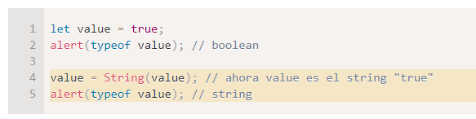
Modulo 1: 5. Conversión de tipos https://es.javascript.info/type-conversions
ToString
La conversión a string ocurre cuando necesitamos la representación en forma de texto de un valor.
Por ejemplo, alert(value) lo hace para mostrar el valor como texto.
También podemos llamar a la función String(value) para convertir un valor a string:

Slide 13
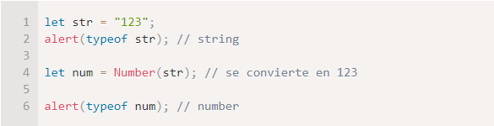
Modulo 1: 5. Conversión de tipos https://es.javascript.info/type-conversions
ToNumber
La conversión numérica ocurre automáticamente en funciones matemáticas y expresiones.
Por ejemplo, cuando se dividen valores no numéricos usando /
Podemos usar la función Number(value) para convertir de forma explícita un valor a un número:

Slide 14
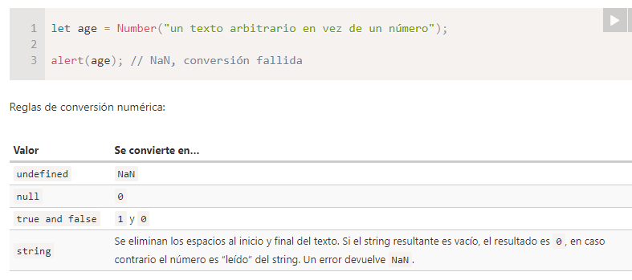
Modulo 1: 5. Conversión de tipos https://es.javascript.info/type-conversions
La conversión explícita es requerida usualmente cuando leemos un valor desde una fuente basada en texto, como lo son los campos de texto en los formularios, pero que esperamos que contengan un valor numérico.
Si el string no es un número válido, el resultado de la conversión será NaN. Por ejemplo:

Slide 15
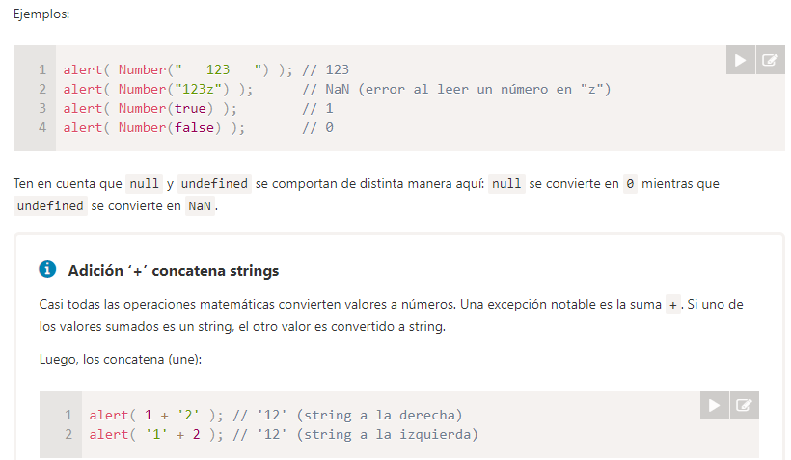
Modulo 1: 5. Conversión de tipos https://es.javascript.info/type-conversions

Slide 16
Modulo 1: 5. Conversión de tipos https://es.javascript.info/type-conversions
ToBoolean
La conversión a boolean es la más simple.
Ocurre en operaciones lógicas (más adelante veremos test condicionales y otras cosas similares) pero también puede realizarse de forma explícita llamando a la función Boolean(value).
Las reglas de conversión:
Los valores que son intuitivamente “vacíos”, como 0, "", null, undefined, y NaN, se convierten en false.
Otros valores se convierten en true.

Slide 17
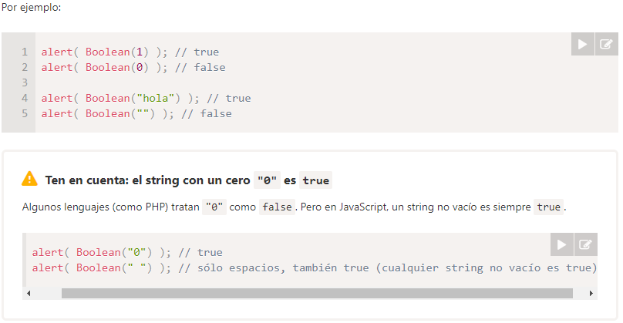
Modulo 1: 5. Conversión de tipos https://es.javascript.info/type-conversions

Slide 18
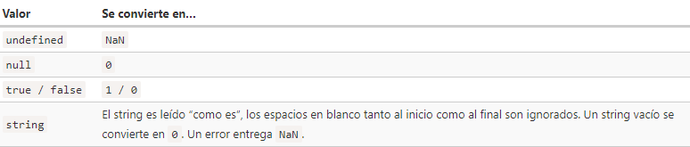
Modulo 1: 5. Conversión de tipos https://es.javascript.info/type-conversions
Resumen
Las tres conversiones de tipo más usadas son a string, a número y a boolean.
ToString – Ocurre cuando se muestra algo. Se puede realizar con String(value). La conversión a string es usualmente obvia para los valores primitivos.
ToNumber – Ocurre en operaciones matemáticas. Se puede realizar con Number(value).
La conversión sigue las reglas:

Slide 19
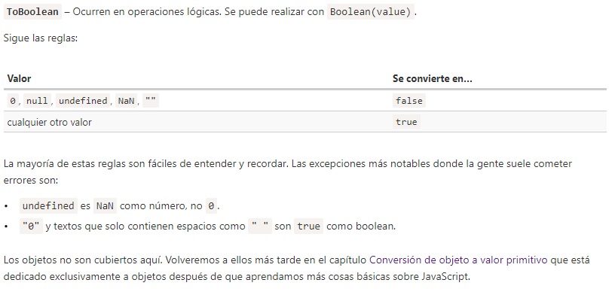
Modulo 1: 5. Conversión de tipos https://es.javascript.info/type-conversions

Slide 20
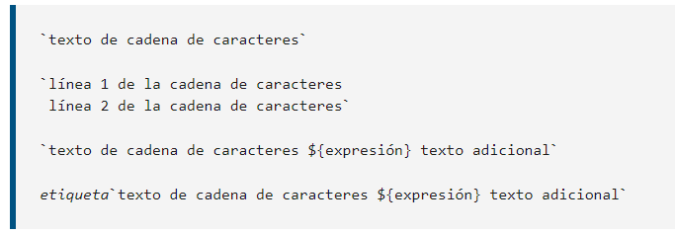
Modulo 1: 6 - Template String (Plantilla de Cadenas) https://developer.mozilla.org/es/docs/Web/JavaScript/Reference/Template_literals
Plantillas literales (plantillas de cadenas)
Las plantillas literales son cadenas literales que habilitan el uso de expresiones incrustadas. Con ellas, es posible utilizar cadenas de caracteres de más de una línea, y funcionalidades de interpolación de cadenas de caracteres.
En ediciones anteriores de la especificación ES2015, solían llamarse "plantillas de cadenas de caracteres".
Sintaxis

Slide 21

Modulo 1: 6 - Template String (Plantilla de Cadenas) https://developer.mozilla.org/es/docs/Web/JavaScript/Reference/Template_literals
Las plantillas literales se delimitan con el caracter de comillas o tildes invertidas (` `) (grave accent), en lugar de las comillas sencillas o dobles.
Las plantillas de cadena de caracteres pueden contener marcadores, identificados por el signo de dólar y envueltos en llaves (${expresión}). Las expresiones contenidas en los marcadores, junto con el texto entre ellas, son enviados como argumentos a una función.
La función por defecto sencillamente concatena las partes para formar una única cadena de caracteres. Si hay una expresión antes de la plantilla literal (aquí indicada mediante etiqueta), se le conoce como "plantilla etiquetada". En este caso, la expresión de etiqueta (típicamente una función) es llamada con la plantilla literal como parámetro, que luego puede ser manipulada antes de ser devuelta.
En caso de querer escapar una comilla o tilde invertida en una plantilla literal, se debe poner una barra invertida (\) antes de la comilla o tilde invertida.

Slide 22
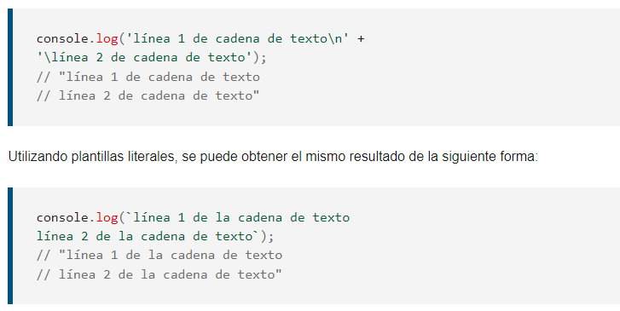
Modulo 1: 6 - Template String (Plantilla de Cadenas) https://developer.mozilla.org/es/docs/Web/JavaScript/Reference/Template_literals
Cadenas de más de una línea
Los caracteres de fin de línea encontrados forman parte de la plantilla literal.
Utilizando cadenas de caracteres normales, sería necesario utilizar la siguiente sintaxes para producir cadenas de más de una línea:

Slide 23
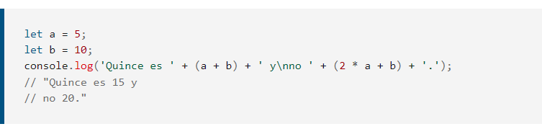
Modulo 1: 6 - Template String (Plantilla de Cadenas) https://developer.mozilla.org/es/docs/Web/JavaScript/Reference/Template_literals
Interpolación de expresiones
Para insertar expresiones dentro de cadenas de caracteres normales, se utilizaría la siguiente sintaxis:

Slide 24
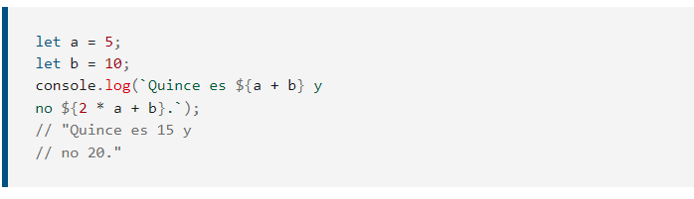
Modulo 1: 6 - Template String (Plantilla de Cadenas) https://developer.mozilla.org/es/docs/Web/JavaScript/Reference/Template_literals
Ahora, con las plantillas literales, se pueden utilizar sus nuevas capacidades (es decir, insertar expresiones con ${ } e incluir caracteres de fin de linea literales dentro de la cadena) para simplificar la sintaxis:

Slide 25
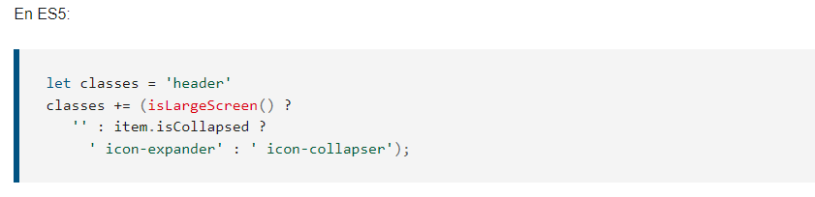
Modulo 1: 6 - Template String (Plantilla de Cadenas) https://developer.mozilla.org/es/docs/Web/JavaScript/Reference/Template_literals
Anidamiento de plantillas
En ciertos casos, anidar una plantilla es la forma más fácil, e incluso más legible, de tener cadenas configurables. Dentro de una plantilla con tildes invertidas, es sencillo permitir tildes invertidas interiores simplemente usándolas dentro de un marcador de posición ${ } dentro de la plantilla.
Por ejemplo, si la condición a es true (cierta): entonces return (devuelva) este literal con plantilla.

Slide 26
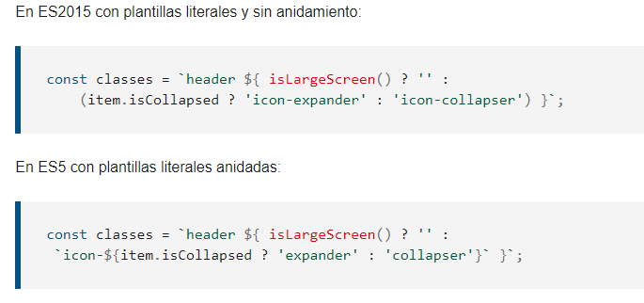
Modulo 1: 6 - Template String (Plantilla de Cadenas) https://developer.mozilla.org/es/docs/Web/JavaScript/Reference/Template_literals
Anidamiento de plantillas

Slide 27

Modulo 1: 7. Arreglos (Arrays) https://www.tutorialspoint.com/javascript/javascript_arrays_object.htm
The Array object lets you store multiple values in a single variable. It stores a fixed-size sequential collection of elements of the same type. An array is used to store a collection of data, but it is often more useful to think of an array as a collection of variables of the same type.
Syntax
Use the following syntax to create an Array object −
The Array parameter is a list of strings or integers. When you specify a single numeric parameter with the Array constructor, you specify the initial length of the array. The maximum length allowed for an array is 4,294,967,295.
You can create array by simply assigning values as follows −

Slide 28
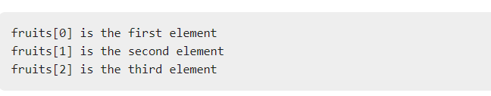
Modulo 1: 7. Arreglos (Arrays) https://www.tutorialspoint.com/javascript/javascript_arrays_object.htm
You will use ordinal numbers to access and to set values inside an array as follows.

Slide 29
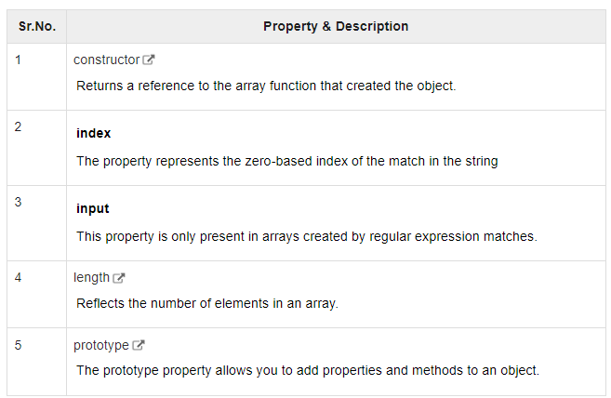
Modulo 1: 7. Arreglos (Arrays) https://www.tutorialspoint.com/javascript/javascript_arrays_object.htm
Properties of Array Object

Slide 30
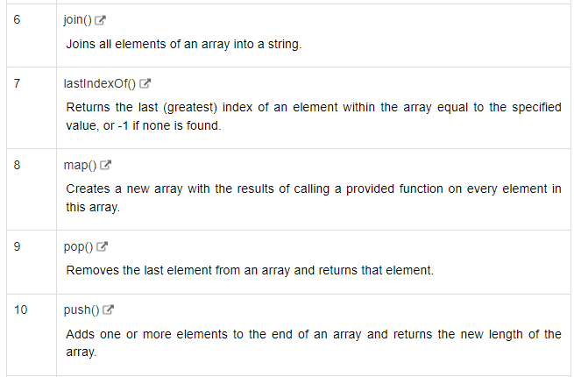
Modulo 1: 7. Arreglos (Arrays) https://www.tutorialspoint.com/javascript/javascript_arrays_object.htm
Array Methods

Slide 31
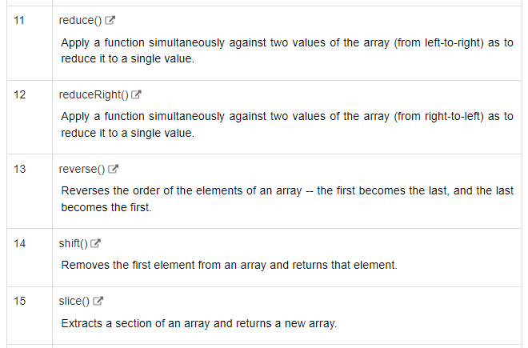
Modulo 1: 7. Arreglos (Arrays) https://www.tutorialspoint.com/javascript/javascript_arrays_object.htm
Array Methods

Slide 32
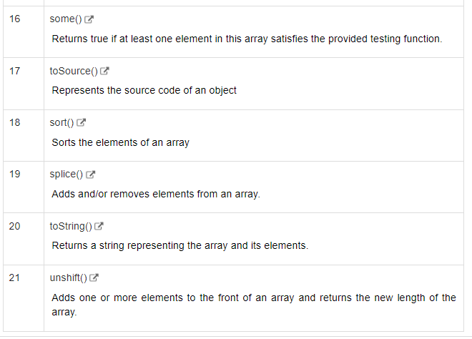
Modulo 1: 7. Arreglos (Arrays) https://www.tutorialspoint.com/javascript/javascript_arrays_object.htm
Array Methods

Slide 33
Modulo 1: 8. Objetos (Objects) https://www.tutorialspoint.com/javascript/javascript_objects.htm
JavaScript is an Object Oriented Programming (OOP) language. A programming language can be called object-oriented if it provides four basic capabilities to developers −
Encapsulation − the capability to store related information, whether data or methods, together in an object.
Aggregation − the capability to store one object inside another object.
Inheritance − the capability of a class to rely upon another class (or number of classes) for some of its properties and methods.
Polymorphism − the capability to write one function or method that works in a variety of different ways.
Objects are composed of attributes. If an attribute contains a function, it is considered to be a method of the object, otherwise the attribute is considered a property.

Slide 34
Modulo 1: 8. Objetos (Objects)
Object Properties
Object properties can be any of the three primitive data types, or any of the abstract data types, such as another object. Object properties are usually variables that are used internally in the object's methods, but can also be globally visible variables that are used throughout the page.
The syntax for adding a property to an object is −
objectName.objectProperty = propertyValue;
For example − The following code gets the document title using the "title" property of the document object.
let str = document.title;

Slide 35
Modulo 1: 8. Objetos (Objects)
Object Methods
Methods are the functions that let the object do something or let something be done to it. There is a small difference between a function and a method – at a function is a standalone unit of statements and a method is attached to an object and can be referenced by the this keyword.
Methods are useful for everything from displaying the contents of the object to the screen to performing complex mathematical operations on a group of local properties and parameters.
For example − Following is a simple example to show how to use the write() method of document object to write any content on the document.
document.write("This is test");

Slide 36
Modulo 1: 8. Objetos (Objects)
User-Defined Objects
All user-defined objects and built-in objects are descendants of an object called Object.
The new Operator
The new operator is used to create an instance of an object. To create an object, the new operator is followed by the constructor method.
In the following example, the constructor methods are Object(), Array(), and Date(). These constructors are built-in JavaScript functions.
let employee = new Object();
let books = new Array("C++", "Perl", "Java");
let day = new Date("August 15, 1947");

Slide 37
Modulo 1: 8. Objetos (Objects)
The Object() Constructor
A constructor is a function that creates and initializes an object. JavaScript provides a special constructor function called Object() to build the object. The return value of the Object() constructor is assigned to a variable.
The variable contains a reference to the new object. The properties assigned to the object are not variables and are not defined with the var keyword.
Example
let book = new Object(); // Create the object
book.subject = "Perl"; // Assign properties to the object
book.author = "Mohtashim";
console.log("Book name is : " + book.subject);
console.log("Book author is : " + book.author);

Slide 38

Modulo 1: 8. Objetos (Objects)
The Object() Constructor
A constructor is a function that creates and initializes an object. JavaScript provides a special constructor function called Object() to build the object. The return value of the Object() constructor is assigned to a variable.
The variable contains a reference to the new object. The properties assigned to the object are not variables and are not defined with the var keyword.
Example
let book = new Object(); // Create the object
book.subject = "Perl"; // Assign properties to the object
book.author = "Mohtashim";
console.log("Book name is : " + book.subject);
console.log("Book author is : " + book.author);

Slide 39
Modulo 1: 8. Objetos (Objects)
Example
function book(title, author) {
this.title = title;
this.author = author;
}
console.log("Book name is : " + book.subject);
console.log("Book author is : " + book.author);

Slide 40
Modulo 1: 8. Objetos (Objects)
Example
//Define a function which will work as a method
function addPrice(amount) {
this.price = amount;
}
function book(title, author) {
this.title = title;
this.author = author;
this.addPrice = addPrice; // Assign that method as property.
}
console.log("Book title is : " + myBook.title);
console.log("Book author is : " + myBook.author);
console.log("Book price is : " + myBook.price);

Slide 41

Modulo 1: 8. Objetos (Objects)
Example
//Define a function which will work as a method
function addPrice(amount) {
this.price = amount;
}
function book(title, author) {
this.title = title;
this.author = author;
this.addPrice = addPrice; // Assign that method as property.
}
console.log("Book title is : " + myBook.title);
console.log("Book author is : " + myBook.author);
console.log("Book price is : " + myBook.price);

Slide 42

Modulo 1: 8. Objetos (Objects)
The 'with' Keyword
The ‘with’ keyword is used as a kind of shorthand for referencing an object's properties or methods.
The object specified as an argument to with becomes the default object for the duration of the block that follows. The properties and methods for the object can be used without naming the object.
Syntax
The syntax for with object is as follows −

Slide 43
Modulo 1: 8. Objetos (Objects)
// Define a function which will work as a method
function addPrice(amount) {
with(this) {
price = amount;
}
}
function book(title, author) {
this.title = title;
this.author = author;
this.price = 0;
this.addPrice = addPrice; // Assign that method as property.
}
let myBook = new book("Perl", "Mohtashim");
myBook.addPrice(100);
console.log("Book title is : " + myBook.title);
console.log("Book author is : " + myBook.author);
console.log("Book price is : " + myBook.price);

Slide 44
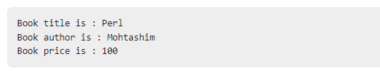
Modulo 1: 8. Objetos (Objects)
// Define a function which will work as a method
function addPrice(amount) {
with(this) {
price = amount;
}
}
function book(title, author) {
this.title = title;
this.author = author;
this.price = 0;
this.addPrice = addPrice; // Assign that method as property.
}
let myBook = new book("Perl", "Mohtashim");
myBook.addPrice(100);
console.log("Book title is : " + myBook.title);
console.log("Book author is : " + myBook.author);
console.log("Book price is : " + myBook.price);

Slide 45
Modulo 1: 9. Funciones en JavaScript https://www.tutorialspoint.com/javascript/javascript_functions.htm
A function is a group of reusable code which can be called anywhere in your program. This eliminates the need of writing the same code again and again. It helps programmers in writing modular codes. Functions allow a programmer to divide a big program into a number of small and manageable functions.
Like any other advanced programming language, JavaScript also supports all the features necessary to write modular code using functions. You must have seen functions like alert(), write() console.log(). We were using these functions again and again, but they had been written in core JavaScript only once.
JavaScript allows us to write our own functions as well. This section explains how to write your own functions in JavaScript.
Function Definition
Before we use a function, we need to define it. The most common way to define a function in JavaScript is by using the function keyword, followed by a unique function name, a list of parameters (that might be empty), and a statement block surrounded by curly braces.

Slide 46
Modulo 1: 9. Funciones en JavaScript https://www.tutorialspoint.com/javascript/javascript_functions.htm
Syntax
function functionname(parameter-list) {
statements
}
Examples:
function sayHello() {
console.log("Hello there");
}
Using Babbel Syntax
const sayHello = () => {
console.log("Hello there");
}
sayHello(); // Calling to the function.

Slide 47
Modulo 1: 9. Funciones en JavaScript https://www.tutorialspoint.com/javascript/javascript_functions.htm
Examples:
function sayHello(name, age) {
console.log(name + " is " + age + " years old.");
}
Using Babbel Syntax
const sayHello = (name, age) => {
console.log(name + " is " + age + " years old.");
}
sayHello(‘Noe Hernandez’, 36); // Calling to the function.

Slide 48
Modulo 1: 9. Funciones en JavaScript https://www.tutorialspoint.com/javascript/javascript_functions.htm
Examples:
Using Babbel Syntax
const sayHello = (name, age) => {
let output = name + " is " + age + " years old.";
return output;
}
sayHello(‘Noe Hernandez’, 36); // Calling to the function.

Slide 49
Modulo 1: 10. Manejando los errores con Try Catch https://developer.mozilla.org/es/docs/Web/JavaScript/Reference/Global_Objects/Error
Error
Los objetos Error se lanzan cuando ocurren errores en tiempo de ejecución. También puedes utilizar el objeto Error como objeto base para excepciones definidas por el usuario. Ve más adelante los tipos de errores estándar integrados.
Descripción
Los errores en tiempo de ejecución dan como resultado la creación y lanzamiento de nuevos objetos Error.

Slide 50
Modulo 1: 10. Manejando los errores con Try Catch https://developer.mozilla.org/es/docs/Web/JavaScript/Reference/Global_Objects/Error
Tipos Error
Además del constructor genérico Error, hay otros siete constructores de errores en el núcleo de JavaScript. Para conocer las excepciones de lado del cliente, consulta Declaraciones para el manejo de excepciones.
EvalError
Crea una instancia que representa un error que ocurre con respecto a la función global eval().
InternalError
Crea una instancia que representa un error que ocurre cuando se produce un error interno en el motor de JavaScript. Por ejemplo: "demasiada recursividad".
RangeError
Crea una instancia que representa un error que ocurre cuando una variable numérica o parámetro está fuera de su rango válido.

Slide 51
Modulo 1: 10. Manejando los errores con Try Catch https://developer.mozilla.org/es/docs/Web/JavaScript/Reference/Global_Objects/Error
Tipos Error
ReferenceError
Crea una instancia que representa un error que ocurre cuando se quita la referencia a una referencia no válida.
SyntaxError
Crea una instancia que representa un error de sintaxis.
TypeError
Crea una instancia que representa un error que ocurre cuando una variable o parámetro no es de un tipo válido.
URIError
Crea una instancia que representa un error que ocurre cuando encodeURI() o decodeURI() pasan parámetros no válidos.

Slide 52
Modulo 1: 10. Manejando los errores con Try Catch https://developer.mozilla.org/es/docs/Web/JavaScript/Reference/Global_Objects/Error
Try Catch Exceptions
The try statement lets you test a block of code for errors.
The catch statement lets you handle the error.
The throw statement lets you create custom errors.
The finally statement lets you execute code, after try and catch, regardless of the result.
Errors Will Happen!
When executing JavaScript code, different errors can occur.
Errors can be coding errors made by the programmer, errors due to wrong input, and other unforeseeable things.

Slide 53

Modulo 1: 10. Manejando los errores con Try Catch https://developer.mozilla.org/es/docs/Web/JavaScript/Reference/Global_Objects/Error
JavaScript Throws Errors
When an error occurs, JavaScript will normally stop and generate an error message.
The technical term for this is: JavaScript will throw an exception (throw an error).
Note: JavaScript will actually create an Error object with two properties: name and message.
The throw Statement
The throw statement allows you to create a custom error.
Technically you can throw an exception (throw an error).
The exception can be a JavaScript String, a Number, a Boolean or an Object:

Slide 54
Modulo 1: 10. Manejando los errores con Try Catch https://developer.mozilla.org/es/docs/Web/JavaScript/Reference/Global_Objects/Error
Examples.
try {
adddlert("Welcome guest!");
}
catch(err) {
console.log(err.message);
}

Slide 55
Modulo 1: 10. Manejando los errores con Try Catch https://developer.mozilla.org/es/docs/Web/JavaScript/Reference/Global_Objects/Error
Examples.
try {
adddlert("Welcome guest!");
}
catch(err) {
console.log(err.message);
}
Output
adddlert is not defined

Slide 56
Modulo 1: 10. Manejando los errores con Try Catch https://developer.mozilla.org/es/docs/Web/JavaScript/Reference/Global_Objects/Error
Examples.
let x = 500;
try {
if(x == "") throw "empty";
if(isNaN(x)) throw "not a number";
x = Number(x);
if(x < 5) throw "too low";
if(x > 10) throw "too high";
}
catch(err) {
console.log("Input is " + err);
}

Slide 57
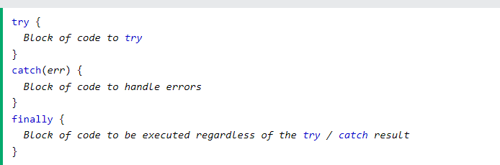
Modulo 1: 10. Manejando los errores con Try Catch https://developer.mozilla.org/es/docs/Web/JavaScript/Reference/Global_Objects/Error
The finally Statement
The finally statement lets you execute code, after try and catch, regardless of the result:

Slide 58
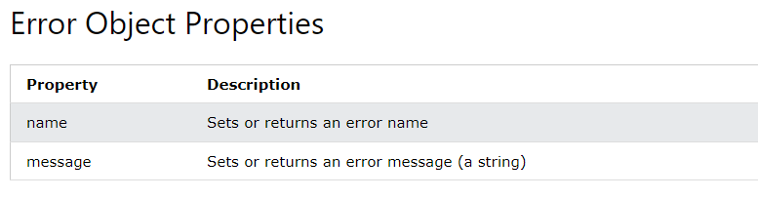
Modulo 1: 10. Manejando los errores con Try Catch https://developer.mozilla.org/es/docs/Web/JavaScript/Reference/Global_Objects/Error
The Error Object
JavaScript has a built in error object that provides error information when an error occurs.
The error object provides two useful properties: name and message.

Slide 59
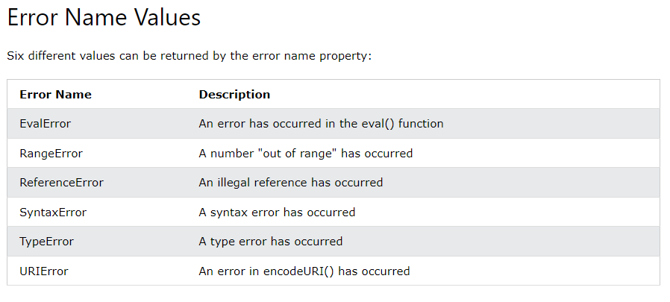
Modulo 1: 10. Manejando los errores con Try Catch https://developer.mozilla.org/es/docs/Web/JavaScript/Reference/Global_Objects/Error

Slide 60
Modulo 1: 11. Fechas en JavaScript (Date) https://www.w3schools.com/js/js_dates.asp
The Date object is a datatype built into the JavaScript language. Date objects are created with the new Date( ) as shown below.
Once a Date object is created, a number of methods allow you to operate on it. Most methods simply allow you to get and set the year, month, day, hour, minute, second, and millisecond fields of the object, using either local time or UTC (universal, or GMT) time.
By default, JavaScript will use the browser's time zone and display a date as a full text string

Slide 61
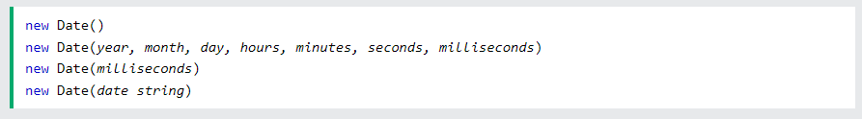
Modulo 1: 11. Fechas en JavaScript (Date) https://www.w3schools.com/js/js_dates.asp
Creating Date Objects
Date objects are created with the new Date() constructor.
There are 4 ways to create a new date object:
Form 1: new Date()
new Date() creates a new date object with the current date and time:

Slide 62
Modulo 1: 11. Fechas en JavaScript (Date) https://www.w3schools.com/js/js_dates.asp
Form 2:
new Date(year, month, ...)
new Date(year, month, ...) creates a new date object with a specified date and time.
7 numbers specify year, month, day, hour, minute, second, and millisecond (in that order):
Form 3:
new Date(dateString)
new Date(dateString) creates a new date object from a date string:

Slide 63
Modulo 1: 11. Fechas en JavaScript (Date) https://www.w3schools.com/js/js_dates.asp
Displaying Dates:

Slide 64
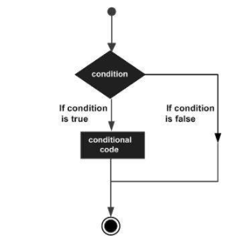
Modulo 1: 12. Estructuras de Control, IF ELSE ELSEIF https://www.tutorialspoint.com/javascript/javascript_ifelse.htm
While writing a program, there may be a situation when you need to adopt one out of a given set of paths. In such cases, you need to use conditional statements that allow your program to make correct decisions and perform right actions.
JavaScript supports conditional statements which are used to perform different actions based on different conditions. Here we will explain the if..else statement.
Flow Chart of if-else
The following flow chart shows how the if-else statement works.
JavaScript supports the following forms of if..else statement −
if statement
if...else statement
if...else if... statement.

Slide 65

Modulo 1: 12. Estructuras de Control, IF ELSE ELSEIF https://www.tutorialspoint.com/javascript/javascript_ifelse.htm
if statement
The if statement is the fundamental control statement that allows JavaScript to make decisions and execute statements conditionally.
Syntax
The syntax for a basic if statement is as follows −
Here a JavaScript expression is evaluated. If the resulting value is true, the given statement(s) are executed. If the expression is false, then no statement would be not executed. Most of the times, you will use comparison operators while making decisions.

Slide 66
Modulo 1: 12. Estructuras de Control, IF ELSE ELSEIF https://www.tutorialspoint.com/javascript/javascript_ifelse.htm
Example
let age = 20;
if( age > 18 ) {
console.log(“Qualifies for driving");
}

Slide 67
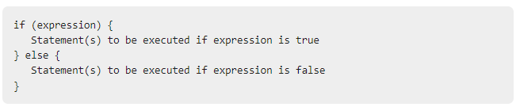
Modulo 1: 12. Estructuras de Control, IF ELSE ELSEIF https://www.tutorialspoint.com/javascript/javascript_ifelse.htm
if...else statement
The 'if...else' statement is the next form of control statement that allows JavaScript to execute statements in a more controlled way.
Example
let age = 15;
if( age > 18 ) {
console.log("Qualifies for driving");
} else {
console.log("Does not qualify for driving");
}

Slide 68
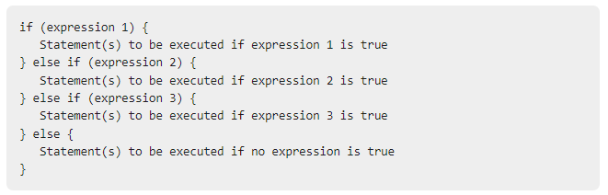
Modulo 1: 12. Estructuras de Control, IF ELSE ELSEIF https://www.tutorialspoint.com/javascript/javascript_ifelse.htm
if...else if... statement
The if...else if... statement is an advanced form of if…else that allows JavaScript to make a correct decision out of several conditions.
Example:
let book = "maths";
if( book == "history" ) {
console.log("History Book");
} else if( book == "maths" ) {
console.log("Maths Book");
} else if( book == "economics" ) {
console.log("Economics Book");
} else {
console.log("Unknown Book");
}

Slide 69
Contenido
A) Modulo 2
Switch en JavaScript
Iteraciones - For Loop
Iteraciones - While y Do While Loop
Map e Iteradores
Desestructuracion de Arreglos & Objetos
Window Object
Scope en JavaScript
¿Que es el DOM?
Manipulacion del DOM
Seleccionando elementos y aplicándole propiedades
Seleccionando múltiples elementos en JavaScript
Traversing en JavaScript

Slide 70
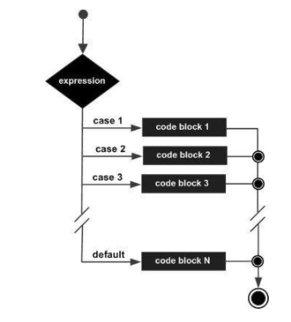
Modulo 2: 1. Switch en JavaScript https://www.w3schools.com/js/js_switch.asp
You can use multiple if...else…if statements to perform a multiway branch. However, this is not always the best solution, especially when all of the branches depend on the value of a single variable.
Switch cases use strict comparison (===).

Slide 71
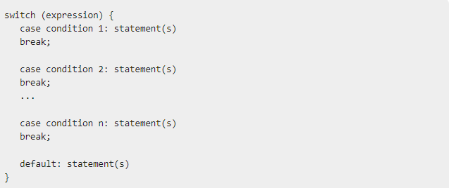
Modulo 2: 1. Switch en JavaScript https://www.w3schools.com/js/js_switch.asp
The objective of a switch statement is to give an expression to evaluate and several different statements to execute based on the value of the expression. The interpreter checks each case against the value of the expression until a match is found. If nothing matches, a default condition will be used.

Slide 72
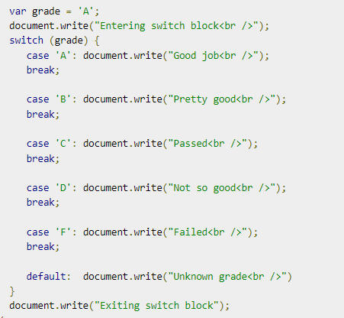
Modulo 2: 1. Switch en JavaScript https://www.w3schools.com/js/js_switch.asp
.

Slide 73
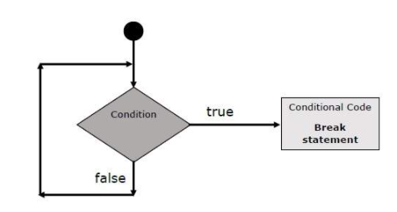
Modulo 2: 2. Iteraciones - For Loop https://www.tutorialspoint.com/javascript/javascript_for_loop.htm
Introduction to Loops
JavaScript provides full control to handle loops and switch statements. There may be a situation when you need to come out of a loop without reaching its bottom. There may also be a situation when you want to skip a part of your code block and start the next iteration of the loop.
To handle all such situations, JavaScript provides break and continue statements. These statements are used to immediately come out of any loop or to start the next iteration of any loop respectively.

Slide 74
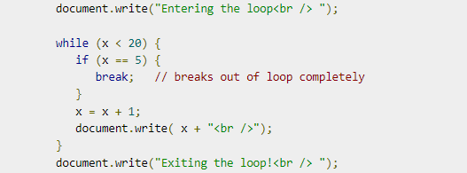
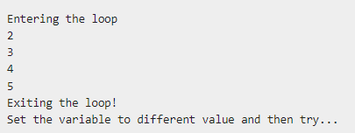
Modulo 2: 2. Iteraciones - For Loop https://www.tutorialspoint.com/javascript/javascript_for_loop.htm
The break Statement
The break statement, which was briefly introduced with the switch statement, is used to exit a loop early, breaking out of the enclosing curly braces.

Slide 75
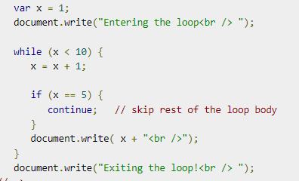
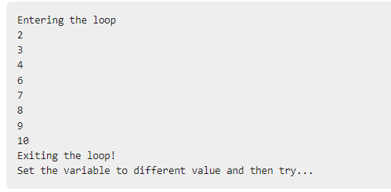
Modulo 2: 2. Iteraciones - For Loop https://www.tutorialspoint.com/javascript/javascript_for_loop.htm
The continue Statement
The continue statement tells the interpreter to immediately start the next iteration of the loop and skip the remaining code block. When a continue statement is encountered, the program flow moves to the loop check expression immediately and if the condition remains true, then it starts the next iteration, otherwise the control comes out of the loop.

Slide 76
Modulo 2: 2. Iteraciones - For Loop https://www.tutorialspoint.com/javascript/javascript_for_loop.htm
The continue Statement
The continue statement tells the interpreter to immediately start the next iteration of the loop and skip the remaining code block. When a continue statement is encountered, the program flow moves to the loop check expression immediately and if the condition remains true, then it starts the next iteration, otherwise the control comes out of the loop.

Slide 77
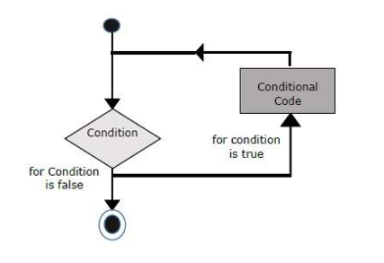

Modulo 2: 2. Iteraciones - For Loop https://www.tutorialspoint.com/javascript/javascript_for_loop.htm
For Loop
The 'for' loop is the most compact form of looping. It includes the following three important parts −
The loop initialization where we initialize our counter to a starting value. The initialization statement is executed before the loop begins.
The test statement which will test if a given condition is true or not. If the condition is true, then the code given inside the loop will be executed, otherwise the control will come out of the loop.
The iteration statement where you can increase or decrease your counter.
You can put all the three parts in a single line separated by semicolons.

Slide 78
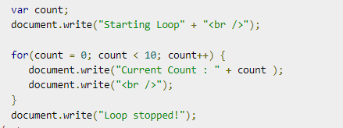
Modulo 2: 2. Iteraciones - For Loop https://www.tutorialspoint.com/javascript/javascript_for_loop.htm
Examples

Slide 79
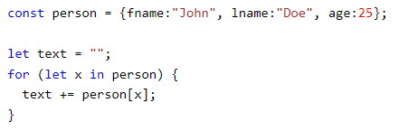
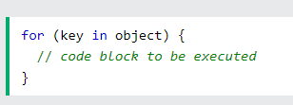
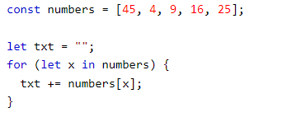
Modulo 2: 2. Iteraciones - For Loop https://www.tutorialspoint.com/javascript/javascript_for_loop.htm
For… In
The for...in loop is used to loop through an object's properties. As we have not discussed Objects yet, you may not feel comfortable with this loop. But once you understand how objects behave in JavaScript, you will find this loop very useful.

Slide 80

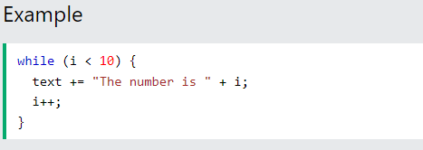
Modulo 2: 3. Iteraciones - While y Do While Loop https://www.w3schools.com/js/js_loop_while.asp
The While Loop
The while loop loops through a block of code as long as a specified condition is true.
Syntax

Slide 81
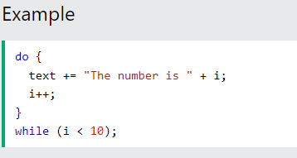

Modulo 2: 3. Iteraciones - While y Do While Loop https://www.w3schools.com/js/js_loop_while.asp
The Do While Loop
The do while loop is a variant of the while loop. This loop will execute the code block once, before checking if the condition is true, then it will repeat the loop as long as the condition is true.
Syntax

Slide 82
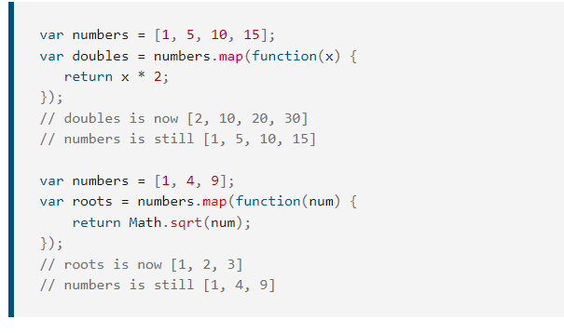
Modulo 2: 4. Map e Iteradores https://developer.mozilla.org/es/docs/Web/JavaScript/Reference/Global_Objects/Array/map
Array.prototype.map()
El método map() crea un nuevo array con los resultados de la llamada a la función indicada aplicados a cada uno de sus elementos.

Slide 83
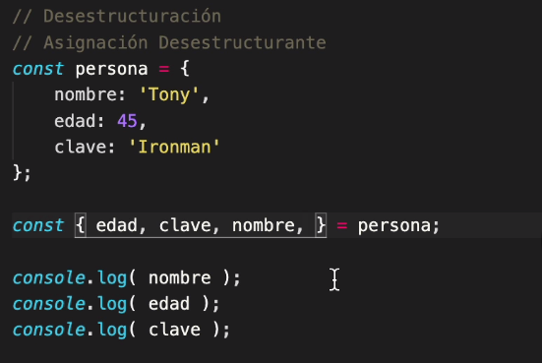
Modulo 2: 5. Desestructuración de Objetos y Arreglos https://developer.mozilla.org/es/docs/Web/JavaScript/Reference/Operators/Destructuring_assignment
La sintaxis de desestructuración es una expresión de JavaScript que permite desempacar valores de arreglos o propiedades de objetos en distintas variables.

Slide 84
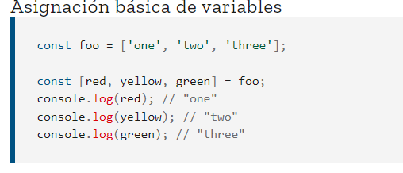
Modulo 2: 5. Desestructuración de Objetos y Arreglos https://developer.mozilla.org/es/docs/Web/JavaScript/Reference/Operators/Destructuring_assignment

Slide 85
Modulo 2: 6. Window Object https://developer.mozilla.org/es/docs/Web/API/Window

Slide 86
Modulo 2: 7. Scope en JavaScript
JavaScript Variable Scope
The scope of a variable is the region of your program in which it is defined. JavaScript variables have only two scopes.
Global Variables − A global variable has global scope which means it can be defined anywhere in your JavaScript code.
Local Variables − A local variable will be visible only within a function where it is defined. Function parameters are always local to that function.
Within the body of a function, a local variable takes precedence over a global variable with the same name. If you declare a local variable or function parameter with the same name as a global variable, you effectively hide the global variable. Take a look into the following example.

Slide 87
Modulo 2: 7. Scope en JavaScript
let myVar = "global"; // Declare a global variable
function checkscope( ) {
let myLet = "local"; // Declare a local variable
document.write(myVar);
}
This produces the following result −
local

Slide 88
Modulo 2: 8. ¿Que es el DOM?

Slide 89
Modulo 2: 9. Manipulacion del DOM

Slide 90
Modulo 2: 10. Seleccionando elementos y aplicándole propiedades

Slide 91
Modulo 2: 11. Seleccionando múltiples elementos en JavaScript

Slide 92
Modulo 2: 12. Traversing en JavaScript

Slide 93
Contenido
A) Modulo 3
Creando Elementos con JavaScript
Reemplazando elementos con JavaScript
Agregando y quitando clases y otros atributos
Events y local storage
Agregando, leyendo, borrando y limpiando el LocalStorage
Event Listener Click
Otros Eventos con el mouse
Eventos para los Inputs
¿Qué es el Event Bubbling?
Delegation en JavaScript
Objetos, constructores, clases y this
Creando Objetos

Slide 94
Modulo 3: 1. Creando Elementos con JavaScript

Slide 95
Modulo 3: 2. Reemplazando elementos con JavaScript

Slide 96
Modulo 3: 3. Agregando y quitando clases y otros atributos

Slide 97
Modulo 3: 4. Events y local storage

Slide 98
Modulo 3: 5. Agregando, leyendo, borrando y limpiando el LocalStorage

Slide 99
Modulo 3: 6. Event Listener Click

Slide 100
Modulo 3: 7. Otros Eventos con el mouse

Slide 101
Modulo 3: 8. Eventos para los Inputs

Slide 102
Modulo 3: 9. ¿Qué es el Event Bubbling?

Slide 103
Modulo 3: 10. Delegation en JavaScript

Slide 104
Modulo 3: 11. Objetos, constructores, clases y this

Slide 105
Modulo 3: 12. Creando Objetos

Slide 106
Contenido
A) Modulo 4
Otros Objetos y Constructores
Prototypes en JavaScript
Heredar Prototypes a otro Objeto
La función Object Create
Ajax, Async y Promises
AJAX y JSON
API's, REST API's y Request
Consumiendo una REST API con Ajax
Que es el Código Asincrono en JavaScript
Callbacks, que son y como funcionan
Promises en JavaScript
Que es Async Await

Slide 107
Modulo 4: 1. Otros Objetos y Constructores

Slide 108
Modulo 4: 2. Prototypes en JavaScript

Slide 109
Modulo 4: 3. Heredar Prototypes a otro Objeto

Slide 110
Modulo 4: 4. La función Object Create

Slide 111
Modulo 4: 5. Ajax, Async y Promises

Slide 112
Modulo 4: 6. AJAX y JSON

Slide 113
Modulo 4: 7. API's, REST API's y Request

Slide 114
Modulo 4: 8. Consumiendo una REST API con Ajax

Slide 115
Modulo 4: 9. Que es el Código Asincrono en JavaScript

Slide 116
Modulo 4: 10. Callbacks, que son y como funcionan

Slide 117
Modulo 4: 11. Promises en JavaScript

Slide 118
Modulo 4: 12. Que es Async Await

Slide 119
Contenido
A) Modulo 5
Que es ECMAScript 6
Creando una Clase
Herencia en Classes con JavaScript
Arrow functions
Asignación por Destructuring
Destructuring a Arreglos y Objetos
Destructuring a Funciones
Symbols
Sets
Maps
Iteradores
Generadores
Contenido Extra

Slide 120
Modulo 5: 1. Que es ECMAScript 6

Slide 121
Modulo 5: 2. Creando una Clase

Slide 122
Modulo 5: 3. Herencia en Classes con JavaScript

Slide 123
Modulo 5: 4. Arrow functions

Slide 124
Modulo 5: 5. Asignación por Destructuring

Slide 125
Modulo 5: 6. Destructuring a Arreglos y Objetos

Slide 126
Modulo 5: 7. Destructuring a Funciones

Slide 127
Modulo 5: 8. Symbols

Slide 128
Modulo 5: 9. Sets

Slide 129
Modulo 5: 10. Maps

Slide 130
Modulo 5: 11. Iteradores

Slide 131
Modulo 5: 12. Generadores

Slide 132
Modulo 5: 13. Contenido Extra

Slide 133
Muchas gracias
=)

